Slide 1

GitHub in HYDR
A practical guide
Paul Muñoz
All-hands meeting 2025
24/09/2025
Notes:
Hi everyone, thanks for being here. Today I want to talk about GitHub and how we can use it in our department.
Some of you may already know GitHub really well, others maybe never touched it before — and that’s perfectly fine. The idea of this session is to show what GitHub can do for us, starting from the very basics and moving towards more advanced things that can really make our work easier, more collaborative, and more visible.
By the end, my hope is that you’ll see GitHub not just as a tool for programmers, but as something that can help all of us share code, data, and results in a way that’s organized, reproducible, and actually fun to use

Slide 2


One place for all our code and workflows
Most computational hydrology is not reproducible, so is it really science? (Hutton et al., 2016)
Improves collaboration inside and outside HYDR
Personal vs. HYDR
Own projects, personal website
HYDR: work done within the department
HYDR
https://github.com/VUB-HYDR
Notes:
Here’s why GitHub is important for us at HYDR. Git is a Distributed version control software, and GitHub: Online storage and access for Git
First, it gives us one central place for all our code and workflows — instead of things being scattered across personal laptops, cloud storage, or emails.
Second, there’s a bigger scientific reason. Hutton and colleagues asked in 2016: if computational hydrology isn’t reproducible, is it really science? GitHub is one of the best tools we have to make our work reproducible — so that others can check, reuse, and build on what we do.
Third, it makes collaboration a lot easier. Whether you’re working with someone in the department or with partners abroad, GitHub helps you share code, track changes, and avoid overwriting each other’s work.
Finally, it’s good to distinguish between personal GitHub and HYDR GitHub. Your personal account is for your own projects, experiments, or even your personal website. HYDR GitHub is where we put the work we do as part of the department. That way, our collective output is visible, organized, and clearly tied to HYDR

Slide 3


Our numbers in GitHub
69 repositories
39 members (17 are former members)
0 projects (shared planning spaces)
1 team only (Groundwater group )
0 Packages (available, but rarely used so far)
Notes:
Here’s a snapshot of our HYDR GitHub today.
We already have 69 repositories — that means 69 collections of code, tools, and workflows from across the department. This is the heart of GitHub: each repo is a self-contained project with files, history, and documentation.
We also have 39 members connected — these are HYDR researchers who already have access.
Interestingly, we have no active Projects yet. Projects are GitHub’s way of organizing tasks or milestones. For us, they could be useful to manage departmental software development or collaborative coding efforts, but so far they’re unused.
There’s only 1 team set up. Teams are meant for research groups or collaborations — for example, each of HYDR’s four research groups could have their own team to manage shared repositories. Right now, this is underutilized.
And finally, Packages. GitHub can also host packages — reusable bits of software like Python libraries or R packages. We haven’t made much use of this, but it could be interesting for tools we develop that might be used by others in the future.
So in short: we have the people and the repos, but there’s still room to make more use of features like Projects, Teams, and Packages to match the way our department works across multiple research groups and projects.”

Slide 4
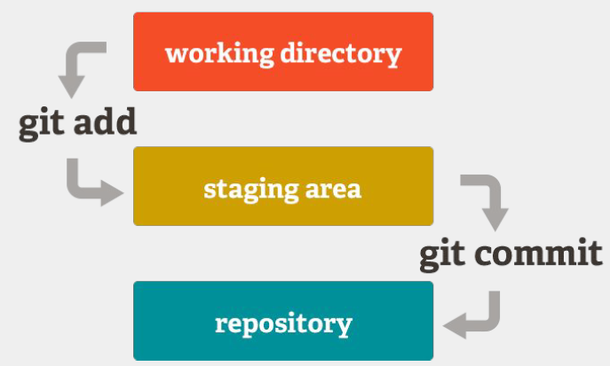
Git & GitHub Basics
Key terminology: repo, commit, branch, fork, pull request
Basic commands
git clone {repo url}
git add {filename}
git commit -m “comments”
git push
git pull
git status
Branching & merging: safe collaboration
Undoing mistakes (reset, revert, checkout)

Slide 5
Git & GitHub Basics
Source: GitHub

Slide 6
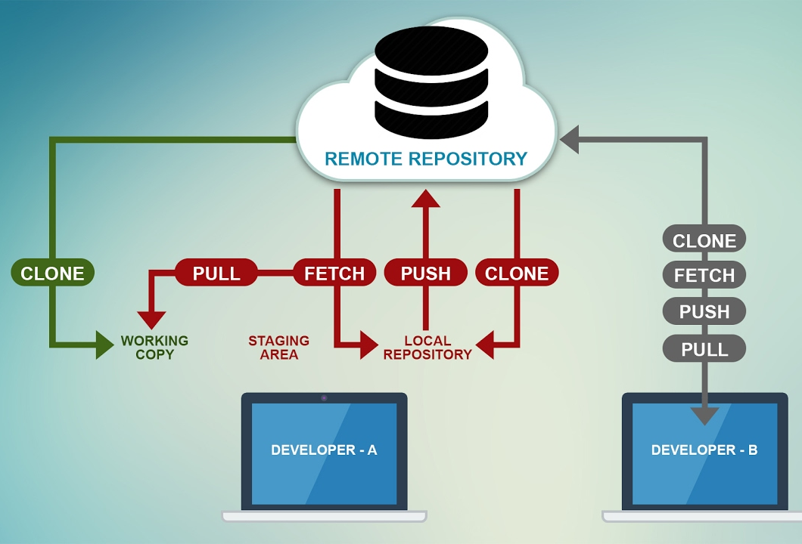

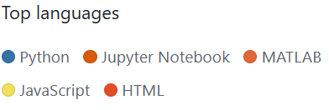
Getting started
1. Installing Git in your machine
2. Setting up a GitHub account & ‘joining’ HYDR
Notes:
“Now, how do we actually use GitHub?
There are three main ways, depending on how comfortable you are with tools.
The simplest is just to use drag-and-drop on the website. You can upload files directly into a repository. This is fine for quick sharing, but it doesn’t give you version control if multiple people are editing.
The second option is GitHub Desktop. This is a program with a clean interface that lets you commit, push, and pull changes with buttons instead of commands. It’s a great entry point if you want more than drag-and-drop but don’t feel like working in the terminal.
Finally, the command line using Git. This is the most powerful and flexible method — it’s what you’ll need if you want to manage branches, merge contributions, or collaborate on bigger projects.
So depending on your needs, you can start simple and move towards GitHub Desktop or the command line as you get more comfortable.”

Slide 7
Getting started
Three ways to interact with GitHub:
Drag-and-drop files online (limited use, not recommended)
GitHub Desktop
Git command line (powerful, flexible, for advanced workflows)
Notes:
“Now, how do we actually use GitHub?
There are three main ways, depending on how comfortable you are with tools.
The simplest is just to use drag-and-drop on the website. You can upload files directly into a repository. This is fine for quick sharing, but it doesn’t give you version control if multiple people are editing.
The second option is GitHub Desktop. This is a program with a clean interface that lets you commit, push, and pull changes with buttons instead of commands. It’s a great entry point if you want more than drag-and-drop but don’t feel like working in the terminal.
Finally, the command line using Git. This is the most powerful and flexible method — it’s what you’ll need if you want to manage branches, merge contributions, or collaborate on bigger projects.
So depending on your needs, you can start simple and move towards GitHub Desktop or the command line as you get more comfortable.”

Slide 8

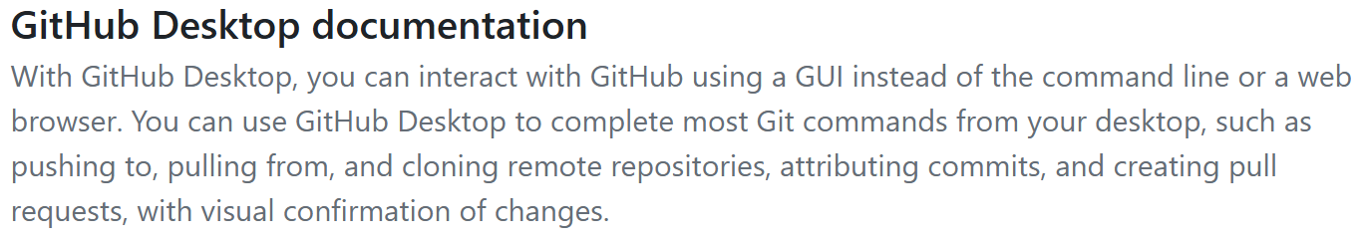
GitHub desktop
https://desktop.github.com/download/
Notes:
“Now, how do we actually use GitHub?
There are three main ways, depending on how comfortable you are with tools.
The simplest is just to use drag-and-drop on the website. You can upload files directly into a repository. This is fine for quick sharing, but it doesn’t give you version control if multiple people are editing.
The second option is GitHub Desktop. This is a program with a clean interface that lets you commit, push, and pull changes with buttons instead of commands. It’s a great entry point if you want more than drag-and-drop but don’t feel like working in the terminal.
Finally, the command line using Git. This is the most powerful and flexible method — it’s what you’ll need if you want to manage branches, merge contributions, or collaborate on bigger projects.
So depending on your needs, you can start simple and move towards GitHub Desktop or the command line as you get more comfortable.”

Slide 9



HYDR conventions
HYDR defines 5 classes of repositories (not official GitHub categories) :
Software → models, big codes
Tools → scripts, pre/post-processors
Publications → code used in papers
Vignettes → tutorials, workflows, documentation
Presentations → slides, seminar material
Naming conventions for repos (esp. publications)
Notes:
No folder organisation for repos

Slide 10
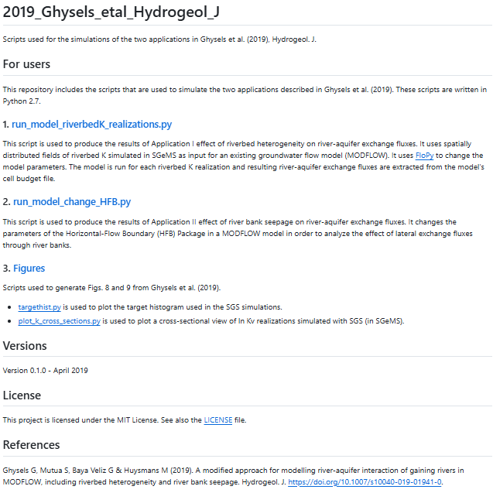
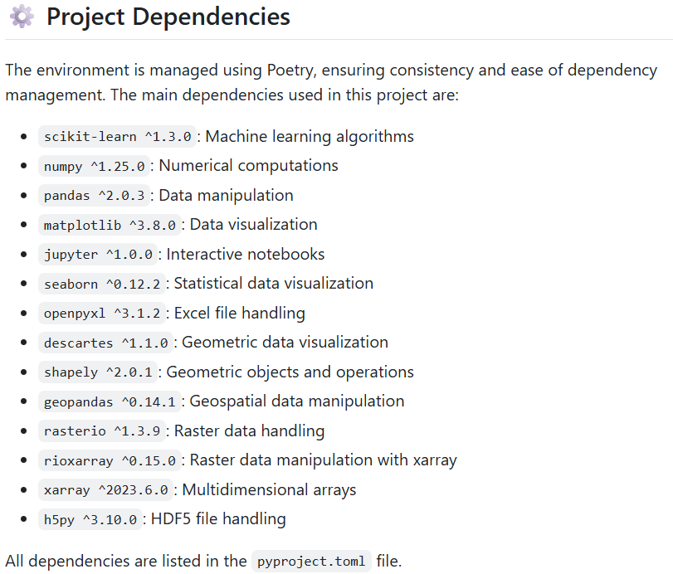
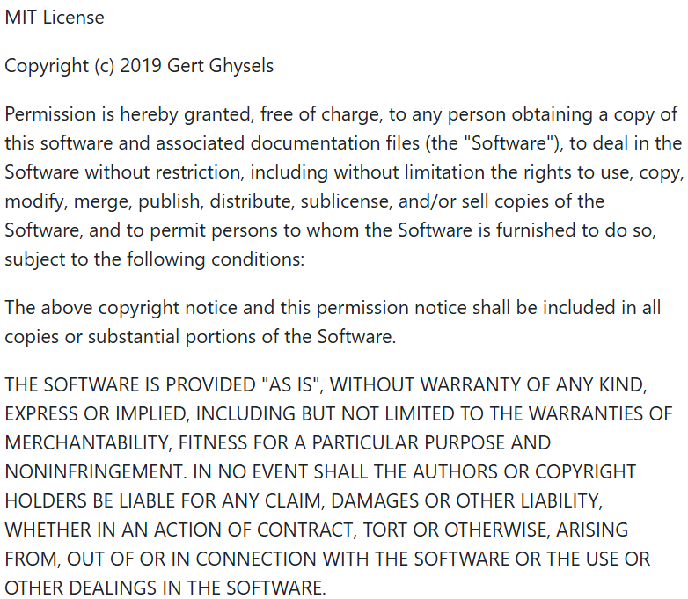
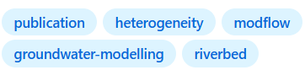
HYDR conventions
Naming conventions for repos
Publications: YYYY_NAME_JOURNAL_SUFFIX
Publication: Ghysels G, Mutua S, Baya Veliz G & Huysmans M (2019). A modified approach for modelling river-aquifer interaction of gaining rivers in MODFLOW, including riverbed heterogeneity and river bank seepage. Hydrogeol.
Metadata requirements:
written in the Markdown “.md” language
SESSIONINFO (mandatory for publications)
README (mandatory)
LICENSE (mandatory)
Optional:
.gitignorem, AUTHORS, CONTRIBUTING, etc.
Repo name: 2019_Ghysels_etal_Hydrogeol_J
Description: Scripts used for the simulations of the two applications in Ghysels et al. (2019), Hydrogeol. J.
Topic: Publication
Notes:
SESSIONINFO file - mandatory for publications
For the publication class, you will have to list all the software, packages or toolboxes you’ve used in
your data analysis including their versions. You can list them directly in your README file or you can
make a separate SESSIONINFO file.
CONTRIBUTING file - optional
If you want to specify certain rules for other people on how to contribute to your repository, you can
create a CONTRIBUTING or CODE OF CONDUCT file. Refer to this file in the README file. A good example
is shown here.
AUTHORS file - optional
If you want to specify all the authors or contributors, in case there are a lot of people who worked on
your repo, you can do so in a AUTHORS file. Refer to this file in the README file. See for example this
authors file.
.gitignore file - optional
If there are certain files in your local repository that you want Git to ignore when committing and
pushing, you can specify these files in a “.gitignore” file which lives in the main repository folder (so
not in a subfolder). You should push the “.gitignore” file itself to your remote repo so other people can
also see what files should be ignored when pushing. To make such a file, open a text editor and type
the names of the files or folders you want to ignore (one line per filename). You can also specify files
in folders by “folder/file”. Save the resulting file as “.gitignore”.

Slide 11
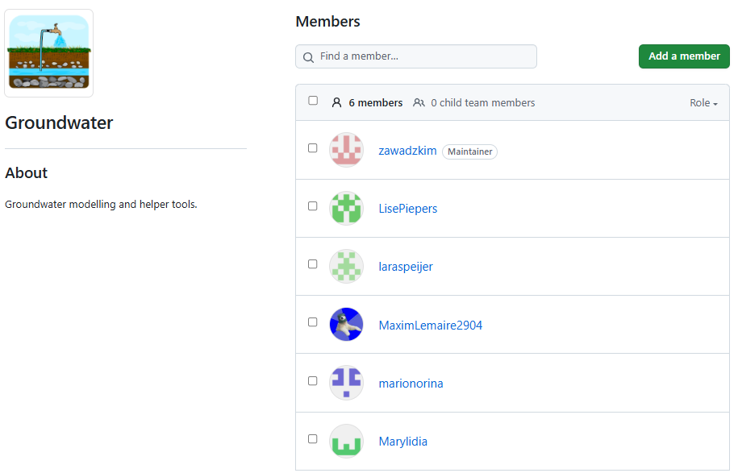
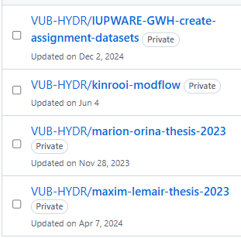
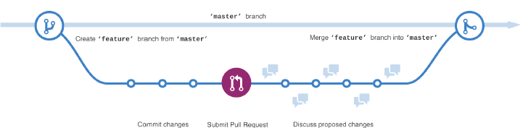
Ways to collaborate
Internal (HYDR) and external collaborators (managed by HYDR owners)
Use a ‘Team’ when multiple people committing to one or more repos (managed by Team owner)
Read-only, cloning, pushing
Feature-branch
vs. forking workflows
Source: GitHub
All changes are made in a separate branch. Members never push directly to the main branch.

Slide 12
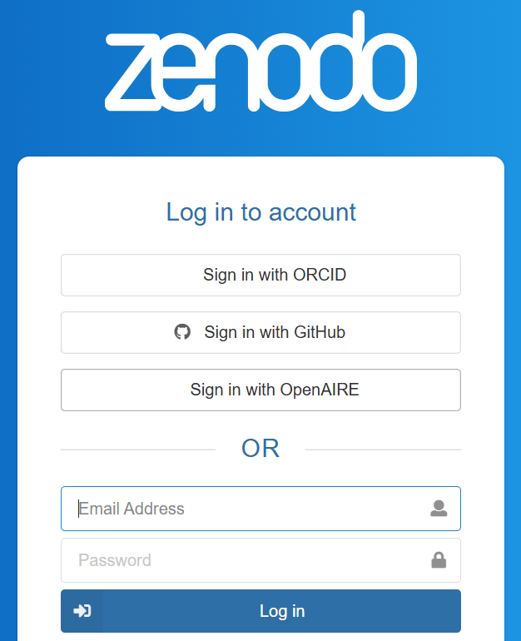
Adding a DOI to your repository
DOI doesn’t get broken
Different code versions with different DOIs
Adding a DOI via Zenodo (https://zenodo.org/)
Steps:
Prepare your repo → README, LICENSE, Create a release (tag version, publish)
Connect GitHub → Zenodo
Add DOI badge in README

Slide 13
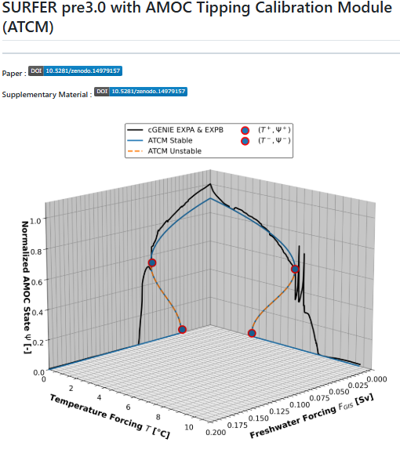
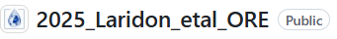
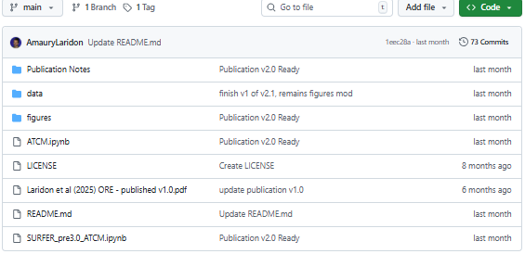
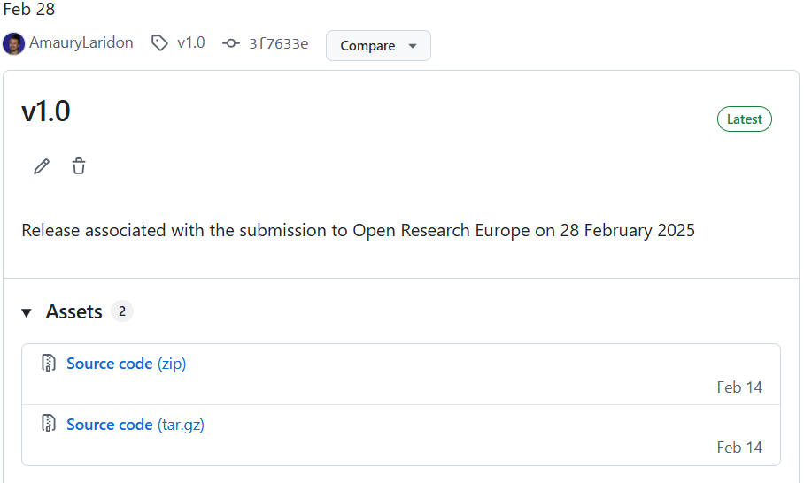
A good example

Slide 14
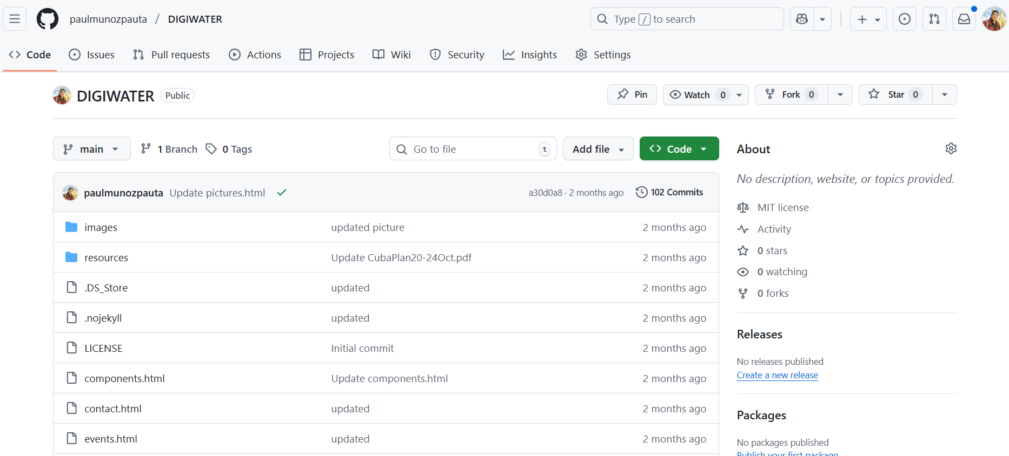
GitHub hosts pages for free
GitHub repository for a Project
Page associated to that repository (https://github.com/VUB-HYDR/2025_DIGIWATER_project)
Optional: buy a domain only, not server (https://digiwater.net/)

Slide 15
Other advanced features
GitHub Actions → automate tasks (e.g., testing, building, or deploying)
Turning code into packages (R, Python)
Projects & Kanban boards → organize tasks and milestones
Issues & Pull Requests → structured way to report bugs, suggest features, and review code
Wikis & Pages → host documentation, guides, or even project websites
Packages → share reusable software components (R, Python, Docker, etc.)
Protected branches & reviews → ensure quality control in collaborative repos

Slide 16
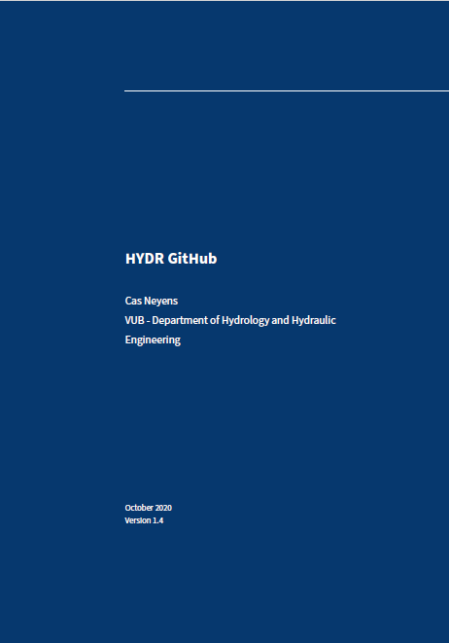
Next steps
Afnan
Amaury
Derrick
Ni
Paul
Talk to your group leader and admin
Special licence for repo?
Add external collaborators
Strongly recommended to have teams either by projects/research groups.
Populate HYDRWiki:
Docjobs: General/practical info
All: Specifics
Docjobs 2025

